Slide 1
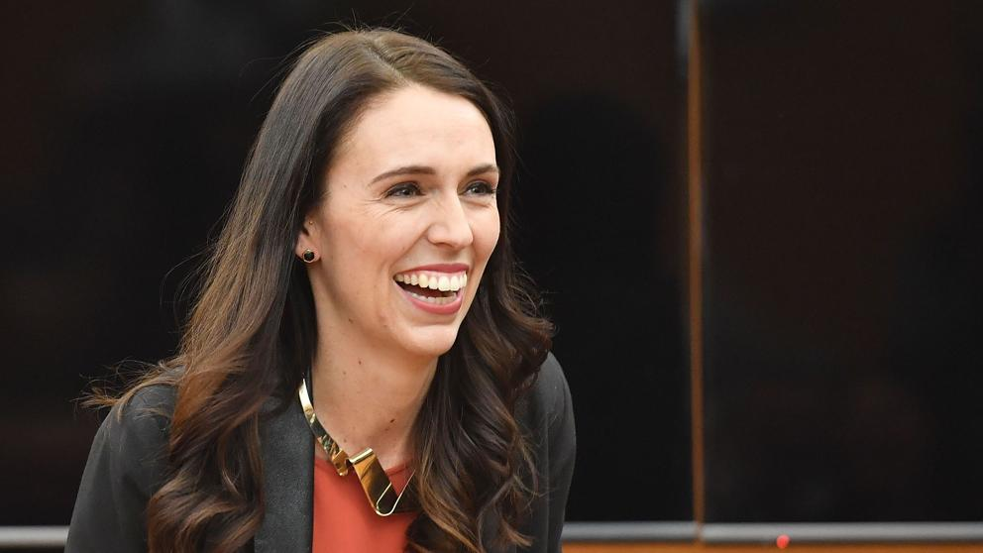
Jacinda Ardern or Adams

Slide 2
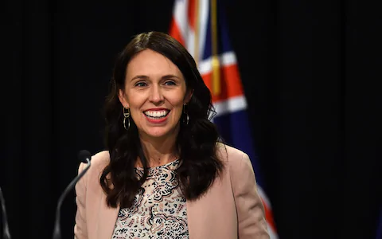
Who is she?
Jacinda Ardern, (born July 26, 1980, Hamilton, New Zealand)
Became leader of the New Zealand Labour Party and then in October 2017, at age 37, became the country’s youngest prime minister in more than 150 years.

Slide 3
“A woman's decision about when she wants to have children should not predetermine whether or not she is offered a job.”

Slide 4
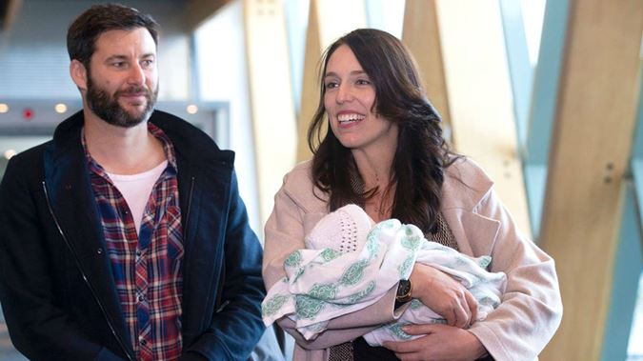
She just returned to the office after her maternity leave: she is the second woman to give birth in the position of leader of a government.

Slide 5
She promised equity for women and to increasing women’s participation in Parliament and so far she has become an example of women’s empowerment.

Slide 6
Jacinda Adams at sciences Po
https://www.youtube.com/watch?v=_YkkjKU71mA

