Slide 1
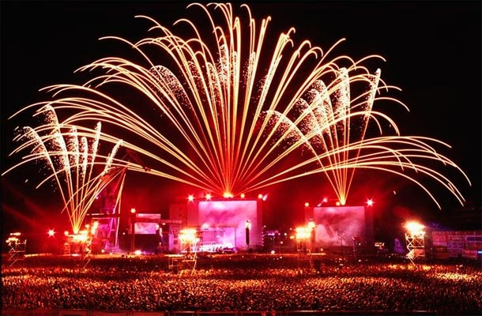
THE BEST FIVE FESTIVALS IN NEW ZELAND

Slide 2
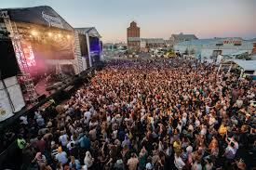
1. LANEWAY FESTIVAL (AUCKLAND)
THIS FESTIVAL STARTED OUT AS A FESTIVAL DOWN SOME LANEWAY IN MELBOURNE, AUSTRALIA. NOW THE FESTIVAL POPS UP IN 8 DIFFERENT CITIES.

Slide 3
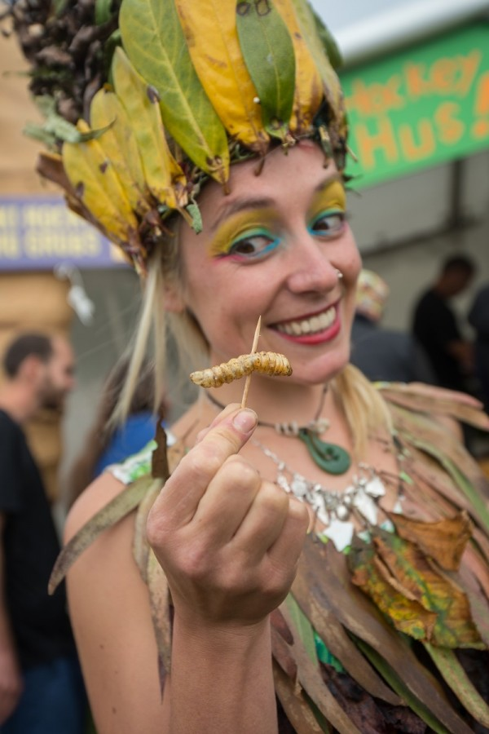
2. HOKITIKA WILDFOODS FESTIVAL (SOUTH ISLAND)
THE HOKITIKA WILDFOODS FESTIVAL NOT BEING IN SUMMER IS JUST A TECHNICALITY THAT CAN BE OVERLOOKED.
THE SOUTH ISLAND WEST COAST EVENT IS A GATHERING OF WEIR FOODS SUCH AS, BOILED POSSUM, CHOCOLATE BEETLESS SEAGULL EGGS, SNAILS, WHITEBAIT PATTIES AND «MOUNTAIN OYSTERS».

Slide 4
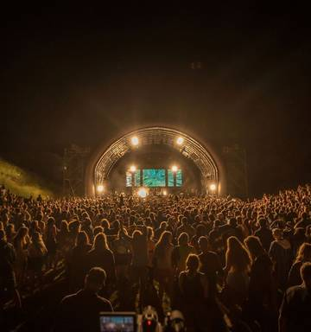
3. SOUNDSPLASH (NORTH ISLAND)
NEW ZELAND`S MOST POPULAR SURF SPORT¡.
THE SMALL NORTH ISLAND TOWN IS ESPECIALLY BUZZING IN JANUARY WITH THE SOUNDSPLASH FESTIVAL WITH HEAPS OF ACTS PERFORMING ACROSS THREE STAGES OVER THREE DAYS.

Slide 5
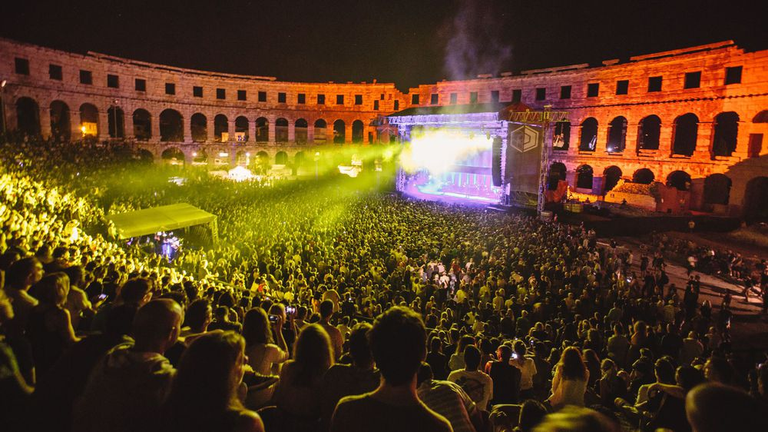
4. DIMENSION (NORTHLAND REGION)
WE CAN ESCAPE TO THIS FOUR DAYS ELECTRONIC MUSIC FESTIVAL FEATURING MORE DOWN 80 INTERNATIONAL AND LOCAL ACTS.
THERE ARE 3 ZONES OF NON STOP MUSIC INCLUDING PSYTRANCE, DNB AND CHILL, AS WELL AS AN EXOTIC MARKET AREA TO TASTE SOME TANTALISING CUISINE.

Slide 6
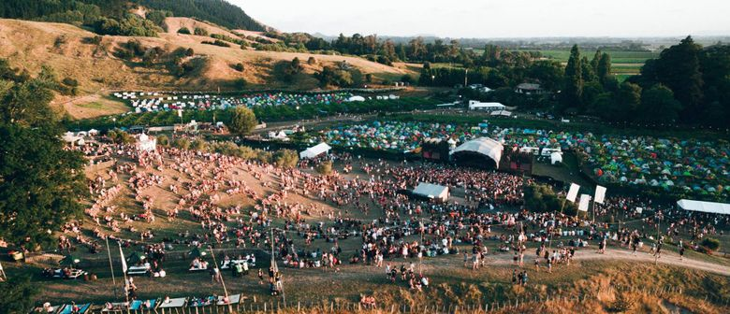
5. RHYTMN AND VINES (GISBORNE)
GISBORNE IS THE FIRST CITY IN THE WORD TO SEE THE NEW YEAR IN, AS IT IS ON NEW ZELAND`S EAST CAPE.
THE 3 DAY SUMMER FESTIVAL CELEBRATE WITH BIG INTERNATIONAL HEATHLINERS

